Slide 1

The Power of Tests in the World of AI
Almantas Karpavičius
2024-11-07
DevCon, Bucharest

Slide 2



About me
Software Engineering team lead at OAG
50% managing, 50% developing
Founder C# Discord with over 9000 members
Made almost 100 videos about programming
3-year Microsoft MVP
Co-author of book “C# Workshop”
Currently writing a book about AI
https://www.linkedin.com/in/almantas-karpavicius/
almantusk@gmail.com

Slide 3
Key Promises of This Presentation
Get universally applicable tips and tricks when it comes to prompt engineering
Understand the importance of Behavior-Driven Development (BDD) and Test-Driven Development (TDD) in the context of AI.
See demos where all of this helps to solve real* problems

Slide 4

Demo

Slide 5






My Setup
GitHub copilot
ChatGPT 4o
Visual Studio Community (latest)
Specflow (latest)
.NET 6 and .NET 8
C#
https://github.com/Almantask/tests-with-ai

Slide 6

How to wield AI as an effective tool?
Featuring ChatGPT

Slide 7
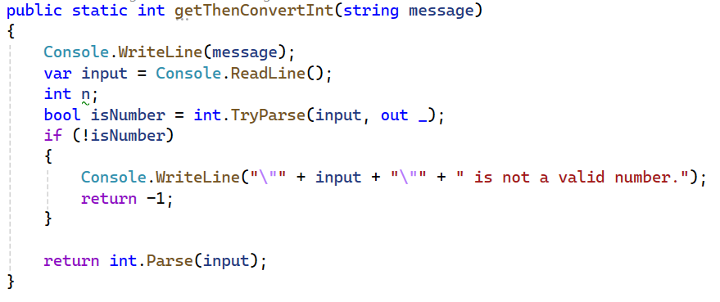
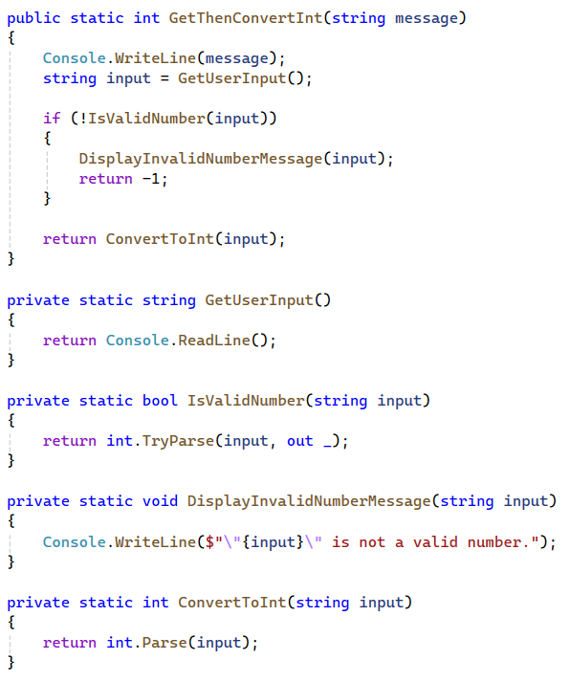
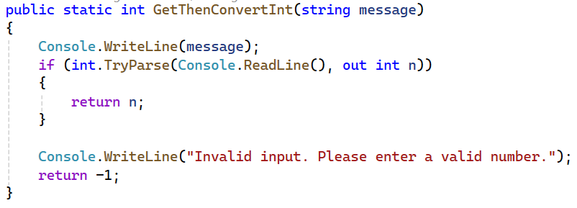
Assign AI a role or even better - a Persona
<code>
Prompt: Assume role of Robert C. Martin (Uncle Bob). Refactor <code>
Prompt: Refactor <code>

Slide 8
What changes when assigning a persona?
No persona
With persona
Other forums
Other books
Uncle Bob books
Uncle Bob books
StackOverflow
Internet
Open Source

Slide 9
Challenge AI by being a being a trampoline
Good conversations happen not when you give a suggestion, but when the other side comes to a conclusion on their own
The same works for AI - ask deeper questions and it will help
Response:
Domain Layer: If FoodEvaluator.cs is closely related to the core domain logic and represents a fundamental concept within the application, it can be placed in the Domain layer. This layer typically contains the domain models, entities, and core business logic.
UseCases Layer: If FoodEvaluator.cs is part of the application's use cases and is responsible for orchestrating the interaction between different components, it can be placed in the UseCases layer. This layer focuses on the application's business logic and use cases.
Prompt: FoodEvaluator.cs is not an external service. It has business logic. Where should it be placed then?

Slide 10
Apply latest docs so that AI is aware
AI is trained up to a certain date
In case something new comes out, it won’t be able to use it
However, you can train the AI yourself with the new data
Response: Since .NET Core and .NET 5+ are being used, consider using a static or singleton HttpClient instance with PooledConnectionLifetime set to the desired interval. This approach ensures both port exhaustion and DNS changes problems are mitigated without adding the overhead of IHttpClientFactory… <code>
Prompt: Apply https://learn.microsoft.com/en-us/dotnet/fundamentals/networking/http/httpclient-guidelines in my test

Slide 11
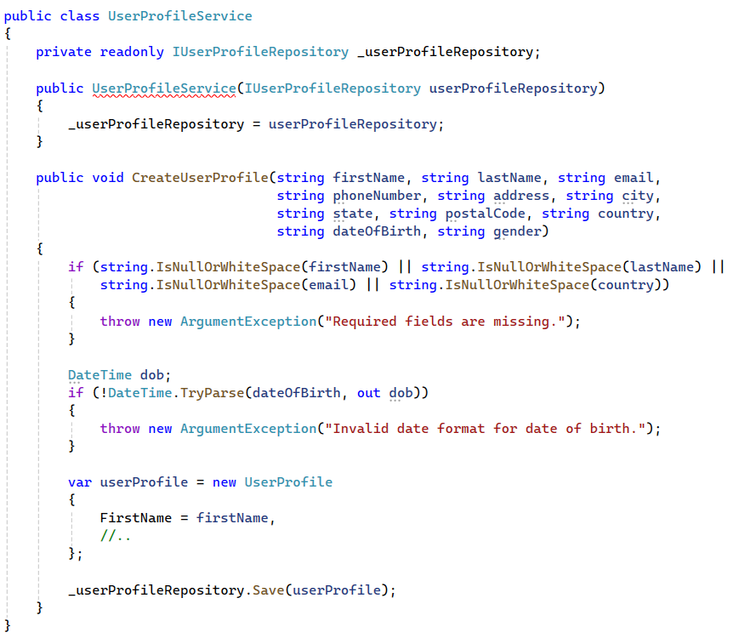
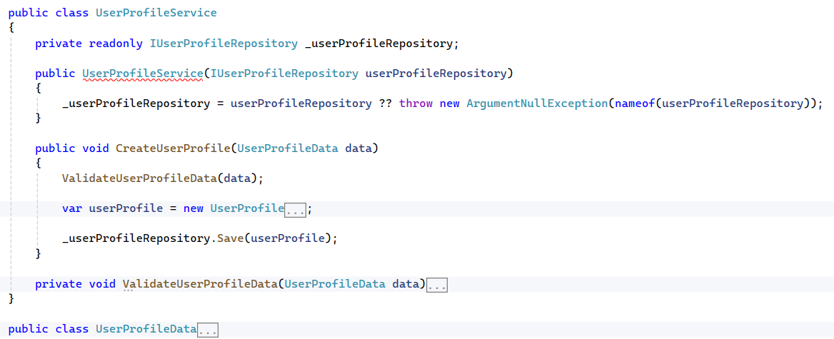
Guide AI to write better code (1)
In doubt? Be general: refactor

Slide 12
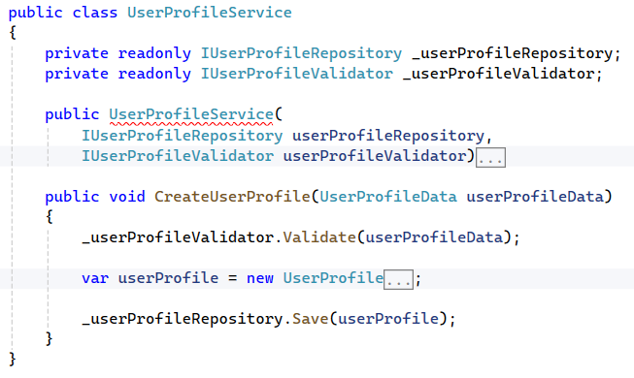
Guide AI to write better code (2)
Have an idea what you want? Specify: apply SOLID principles

Slide 13
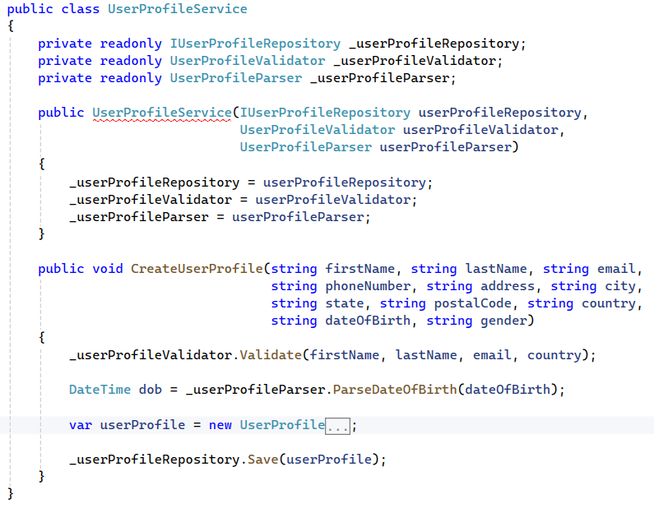
Guide AI to write better code (3)
Want to isolate what is focused on? Specify: apply SRP

Slide 14
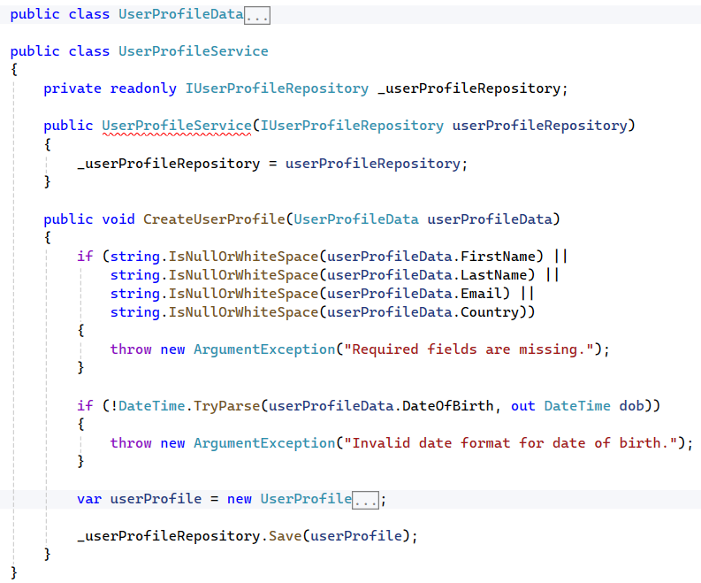
Guide AI to write better code (4)
Know exactly what to do? Say so: refactor this so that the code smell “many arguments” is removed

Slide 15
Challenge AI by being negative
Phrase a prompt in a way that what you have is violating best practices
Prompt: In what ways does this CD pipeline fail to conform to best practices?
Response: Coverage report has hardcoded urls<..>No parallelization<..>...

Slide 16
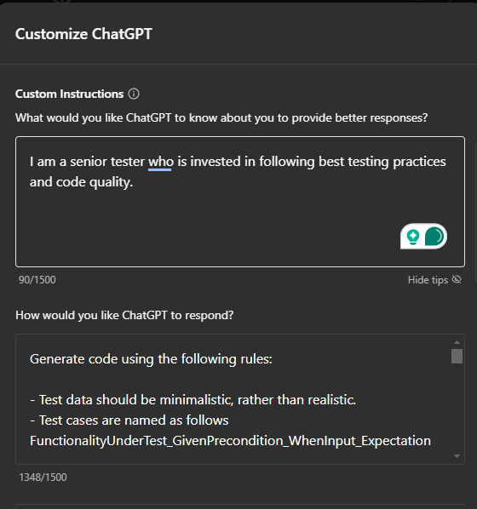
Train AI with ideal examples
Similar to setting a persona, you can specify the style of code you want AI to follow
For OpenAI, there is custom instructions tab
Generate code using the following rules:
- Test data should be minimalistic, rather than realistic.
- Test cases are named as follows FunctionalityUnderTest_GivenPrecondition_WhenInput_Expectation
Example test case names:
- GetUsers_GivenEmptyDb_ReturnsEmptyList
- GetUsers_GivenSingleExistingUser_ReturnsAListOfOneUser
- GetUsers_GivenMultipleExistingUsers_ReturnsAll
- GetUser_WhenNotFound_Returns404
Use 3A.
<A few example test cases>

Slide 17
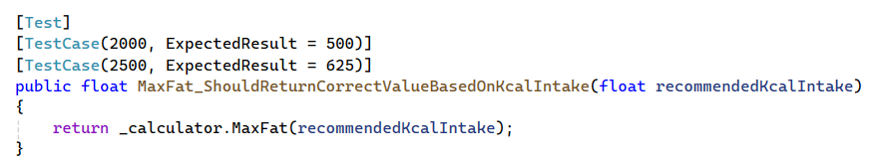
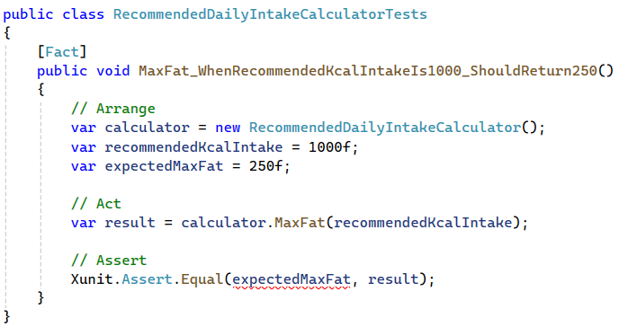
After training

Slide 18

AI is not your employee, it’s just a tool
A tool is not independent
A tool needs to be wielded by a human
Where humans are lacking (typing speed, referencing information) - AI can hugely cover.
Without doubt, EVERY ROLE and EVERY LEVEL OF SENIORITY should learn how to use AI.

Slide 19
Before you even try to use AI, remember this
Juniors,:
Using AI as a tool to do work for you is harmful. You will not grow that way.
Use AI to improve your learning, for it to explain concepts at different levels, give you small guidance.
Don’t forget to double check with a senior whether the advice is legit.
Don’t challenge AI, because it won’t fight back.
Seniors,:
Just as you train juniors, train your AI.
Don’t just ask for code to be generated and complain it’s bad quality.
Guide AI to write good code, just like you would a junior.

Slide 20
Back to the importance of testing in AI era
It takes one good test case to:
Generate other test cases
Generate source code
Verify whether AI-produced code works

Slide 21

Thank you!
Questions?
https://github.com/Almantask/tests-with-ai
almantusk@gmail.com
https://www.linkedin.com/in/almantas-karpavicius/

